Slide 1
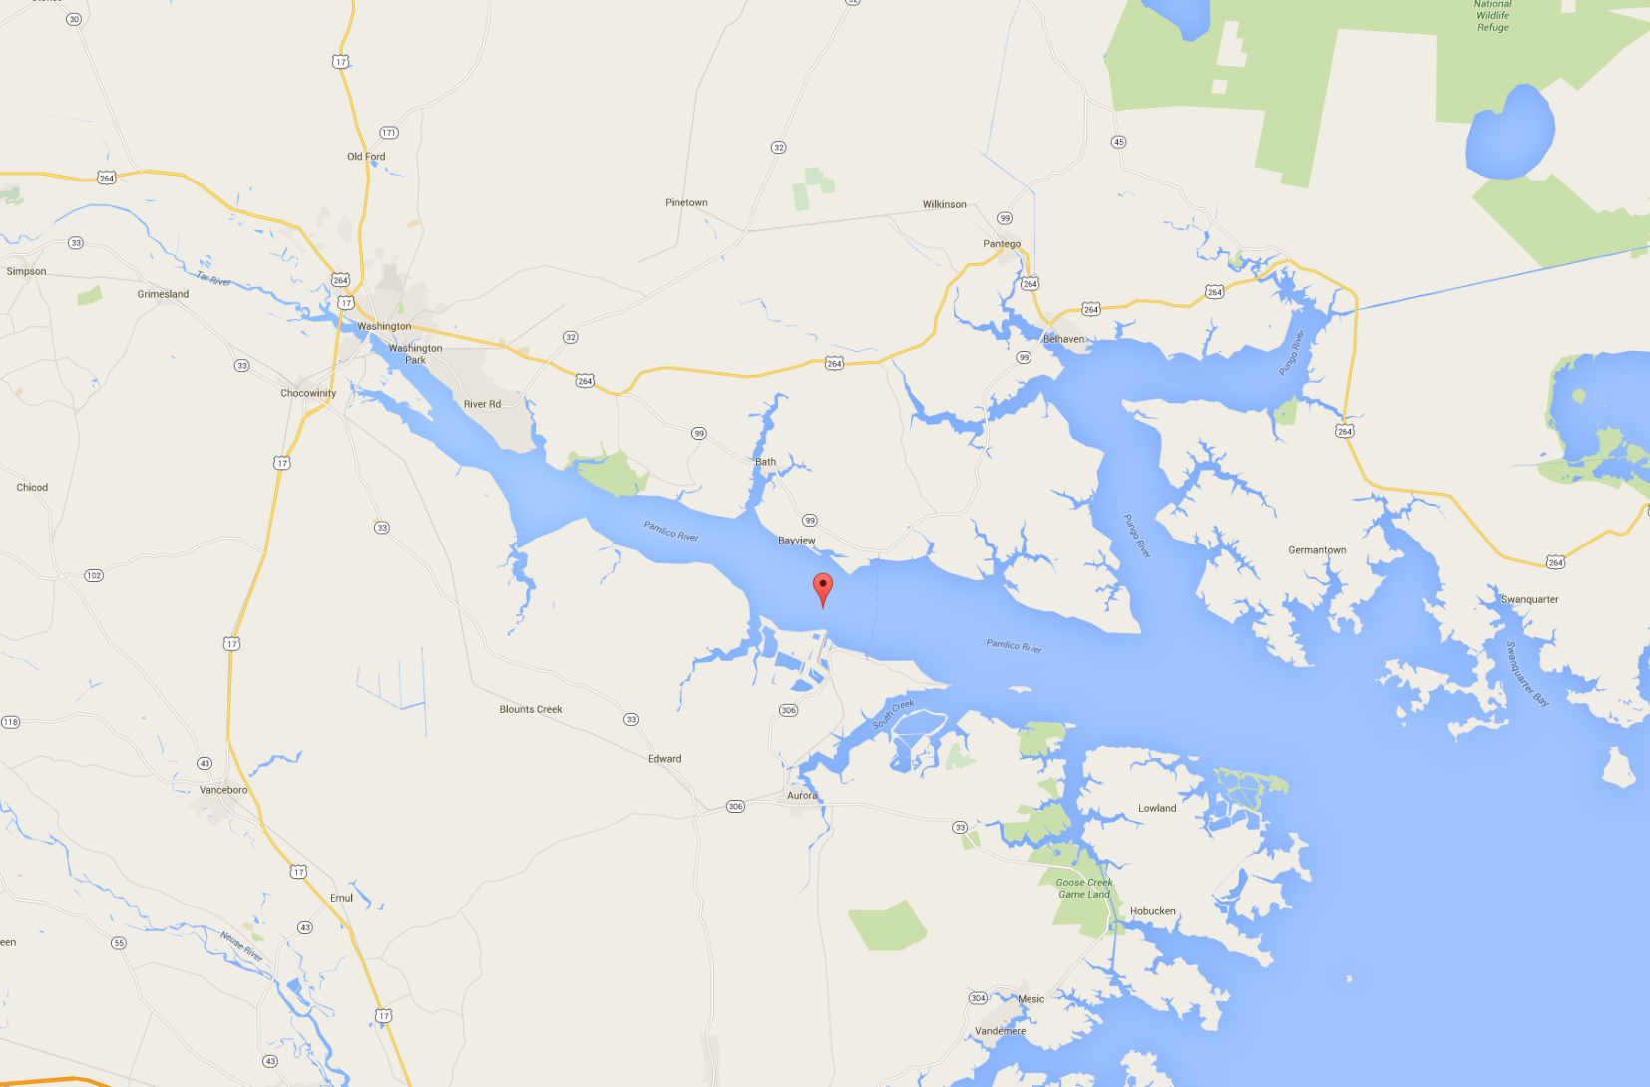
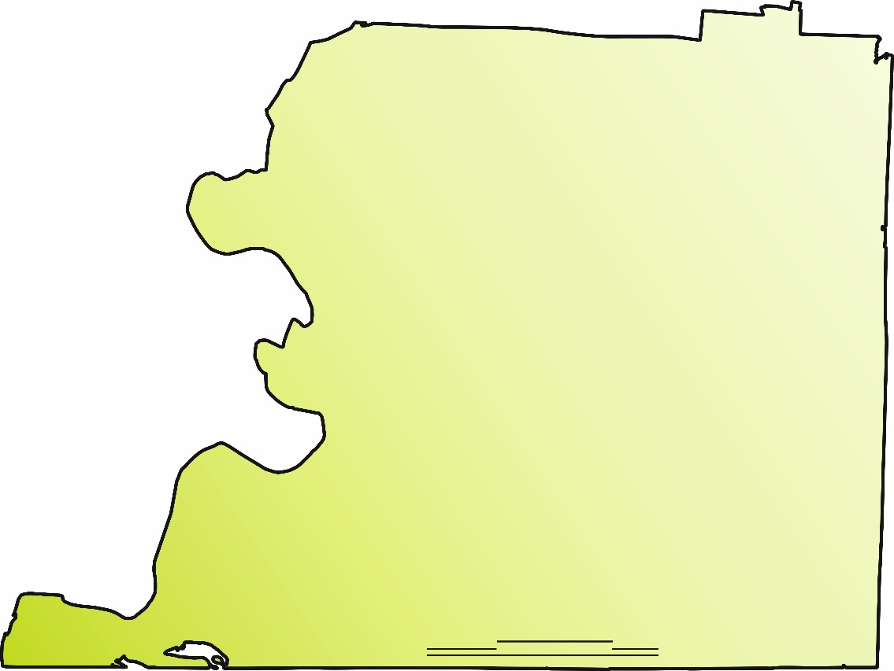

NIST Center of Excellence for Risk-Based Community Resilience Planning
Possible locations for Shelby County
Contour of Shelby County
Pamlico River area
3
5
2 miles

Slide 2
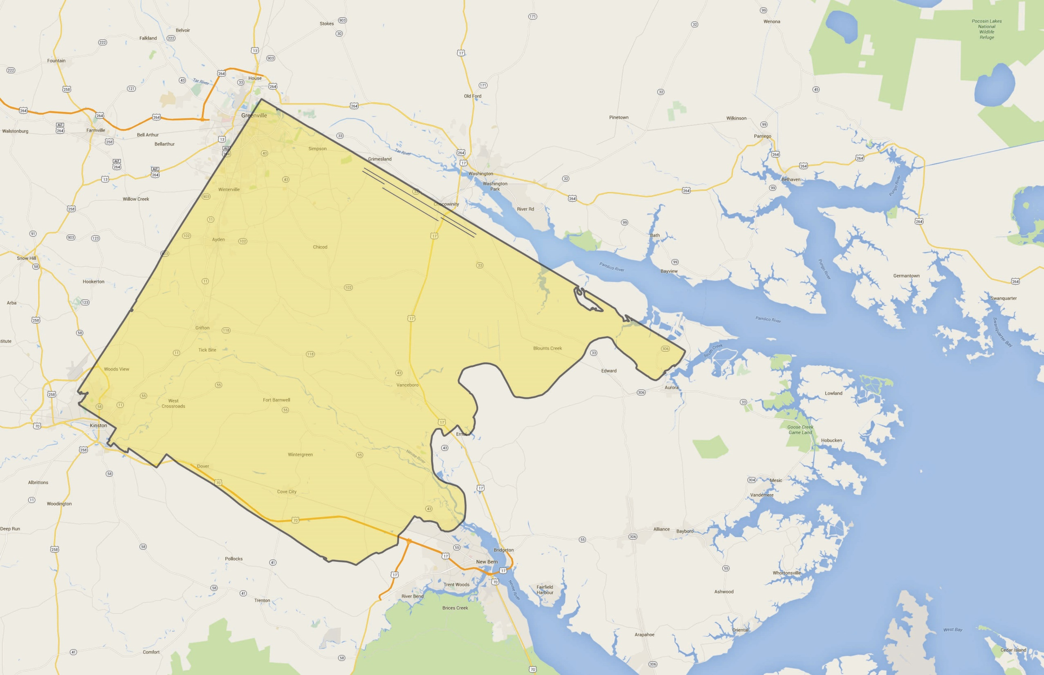
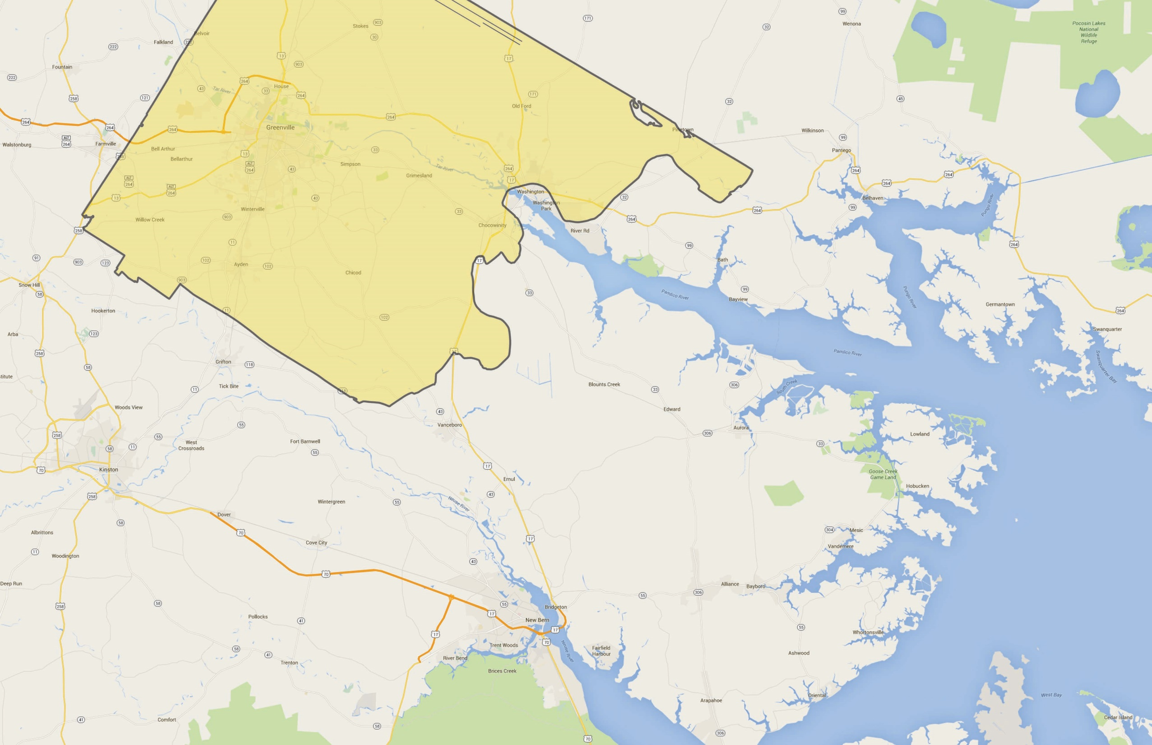
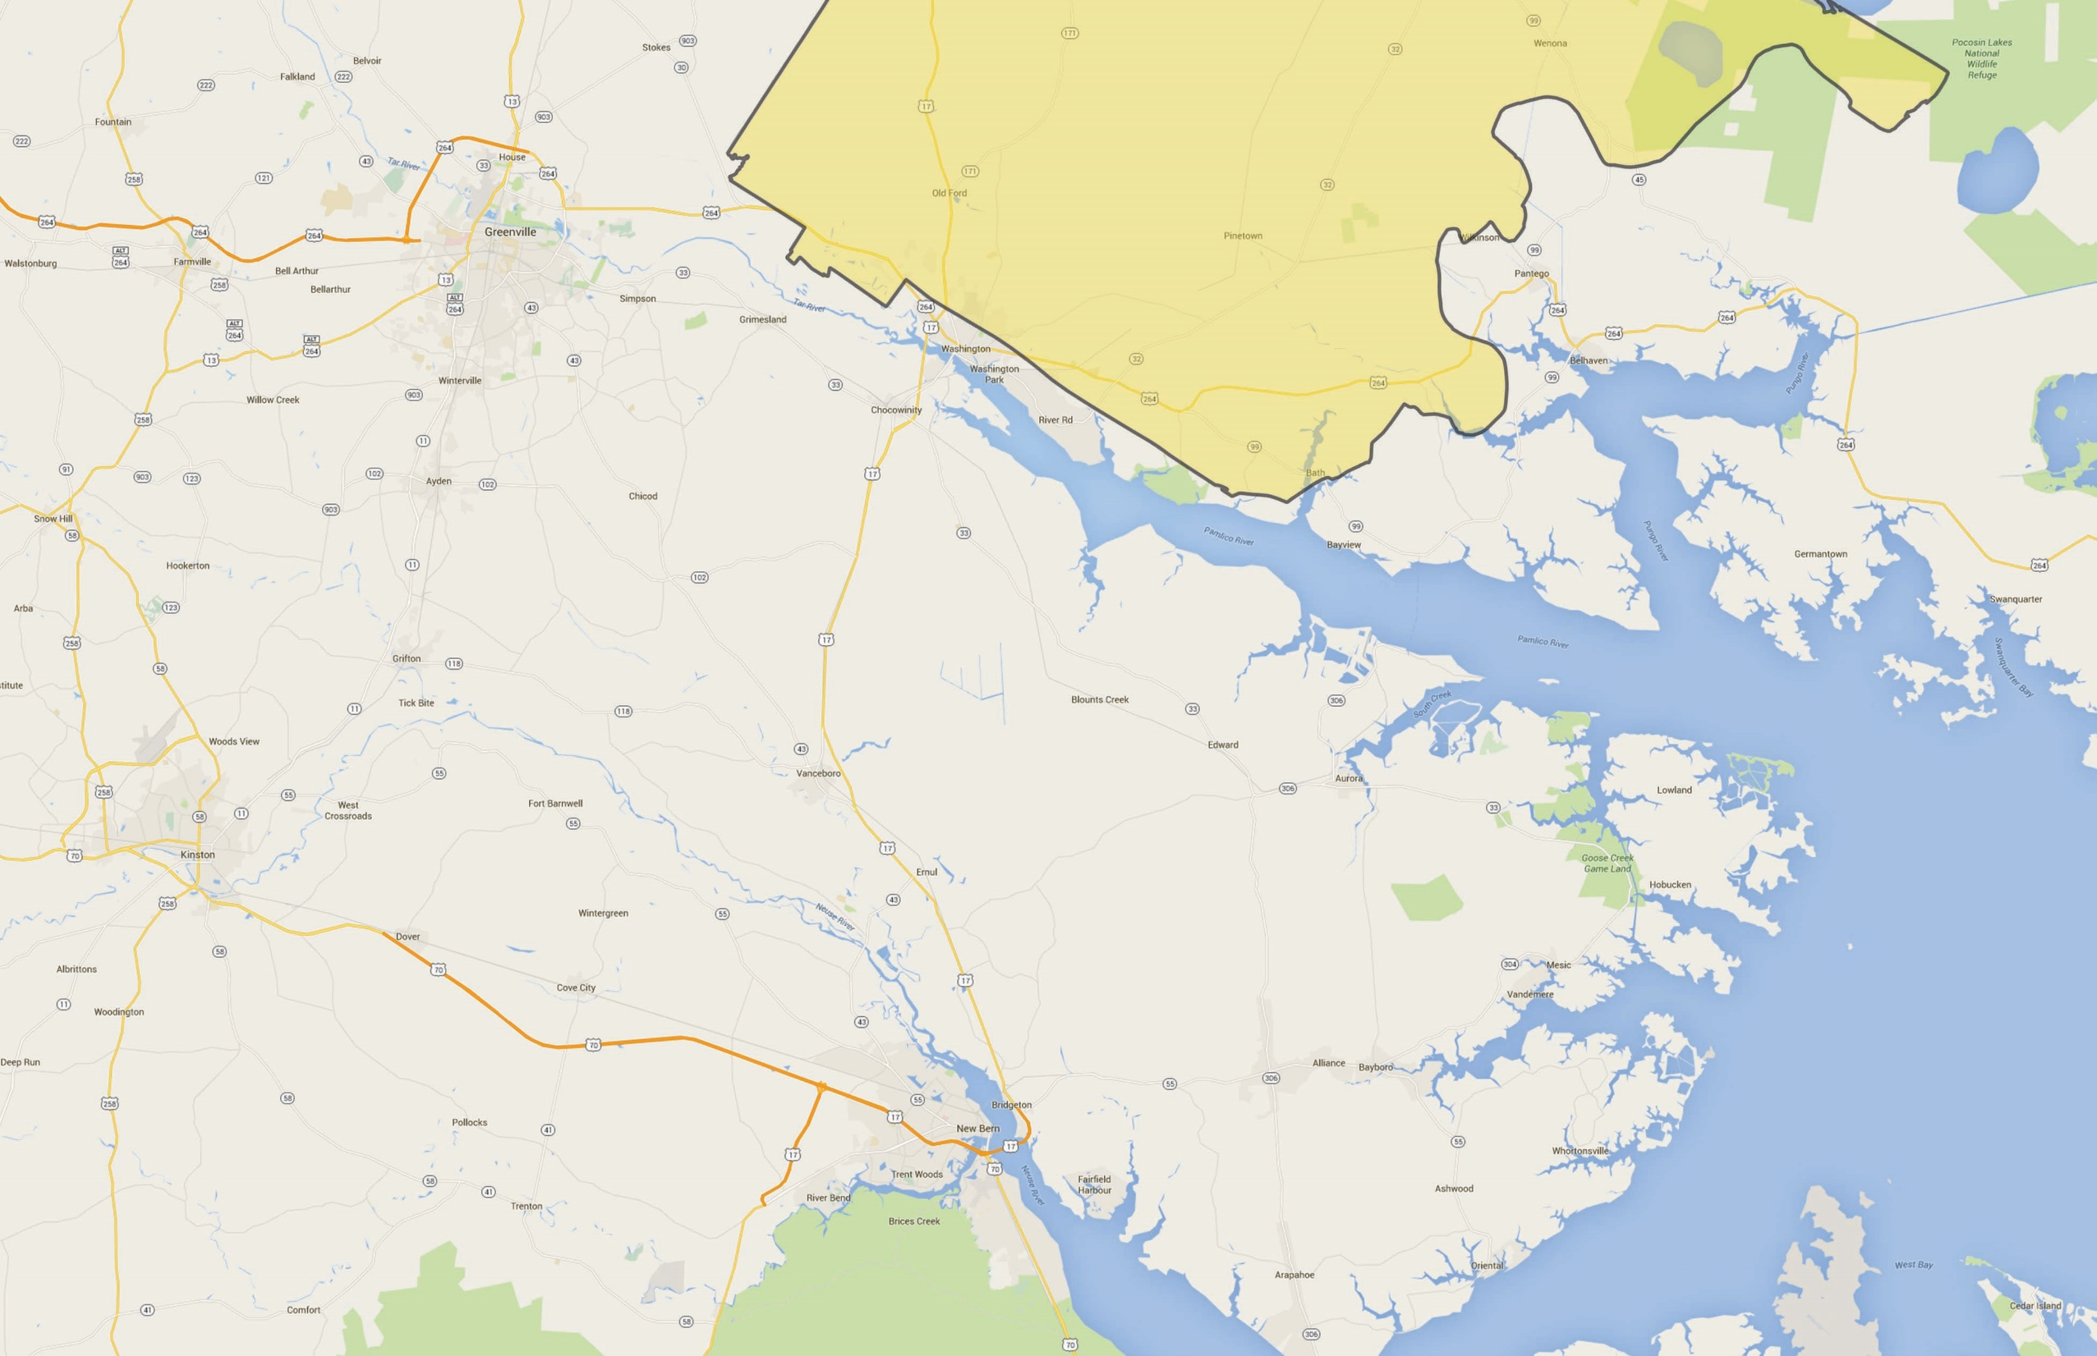
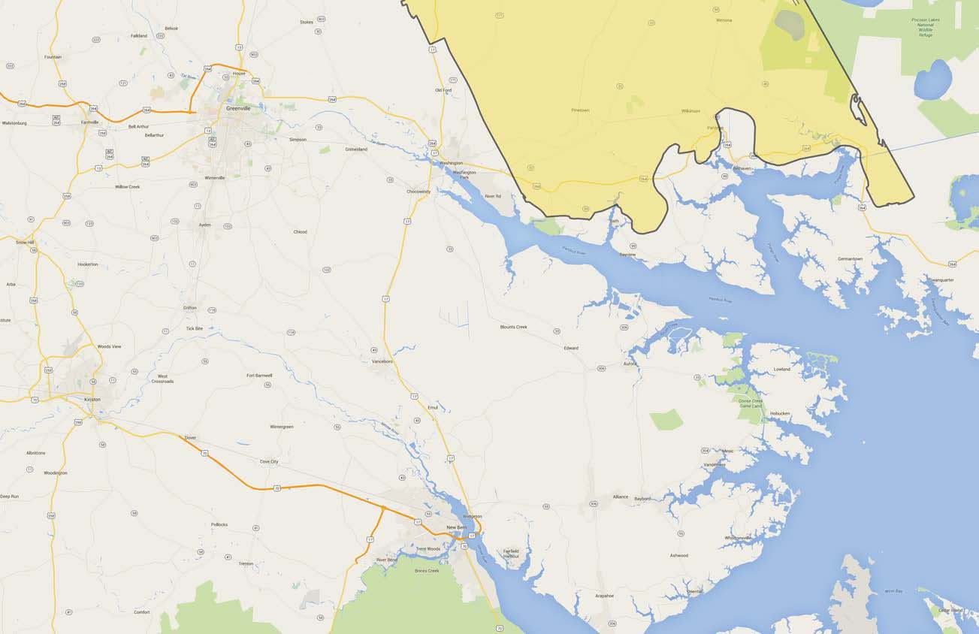
NIST Center of Excellence for Risk-Based Community Resilience Planning
All Shelby County contour on dryland
1
2
3
4

Slide 3
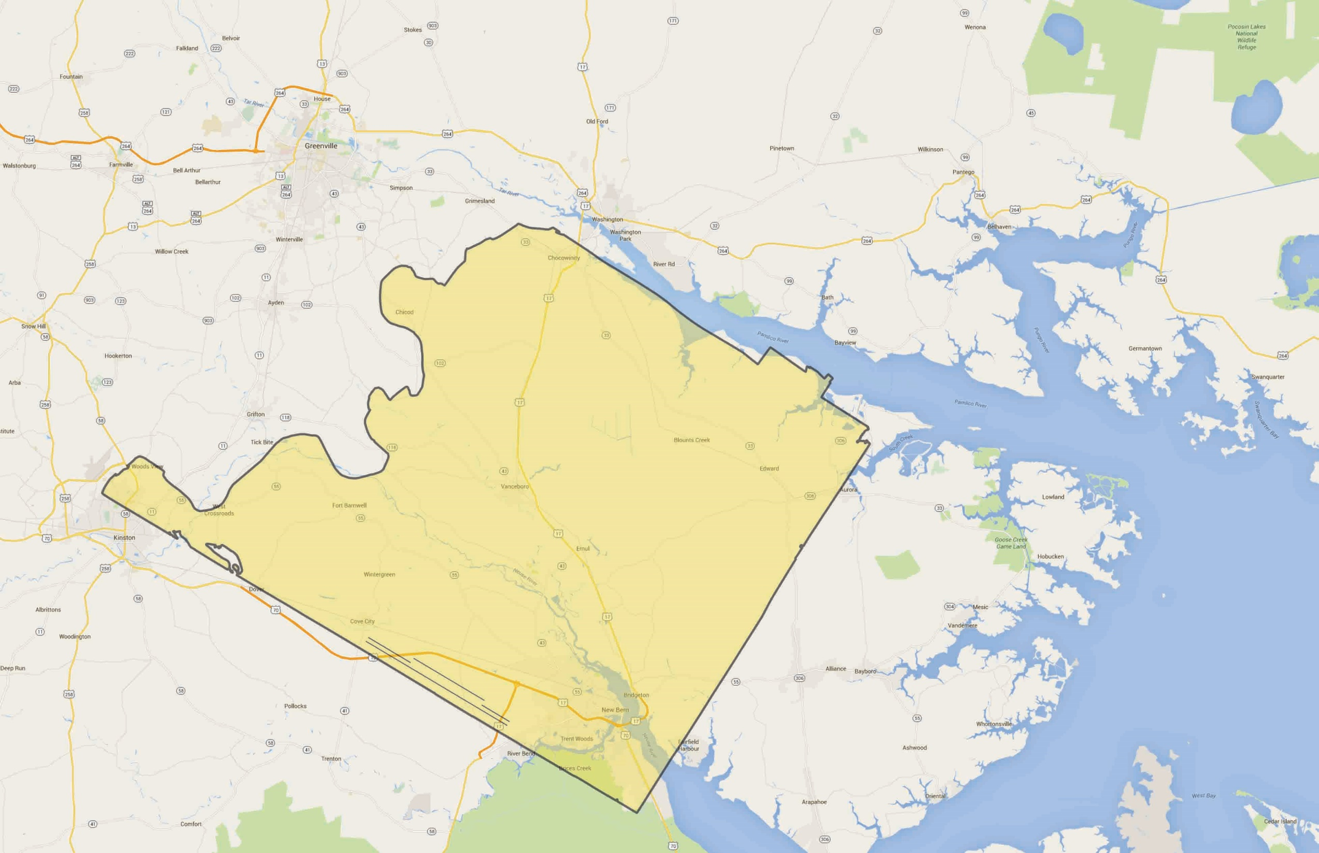
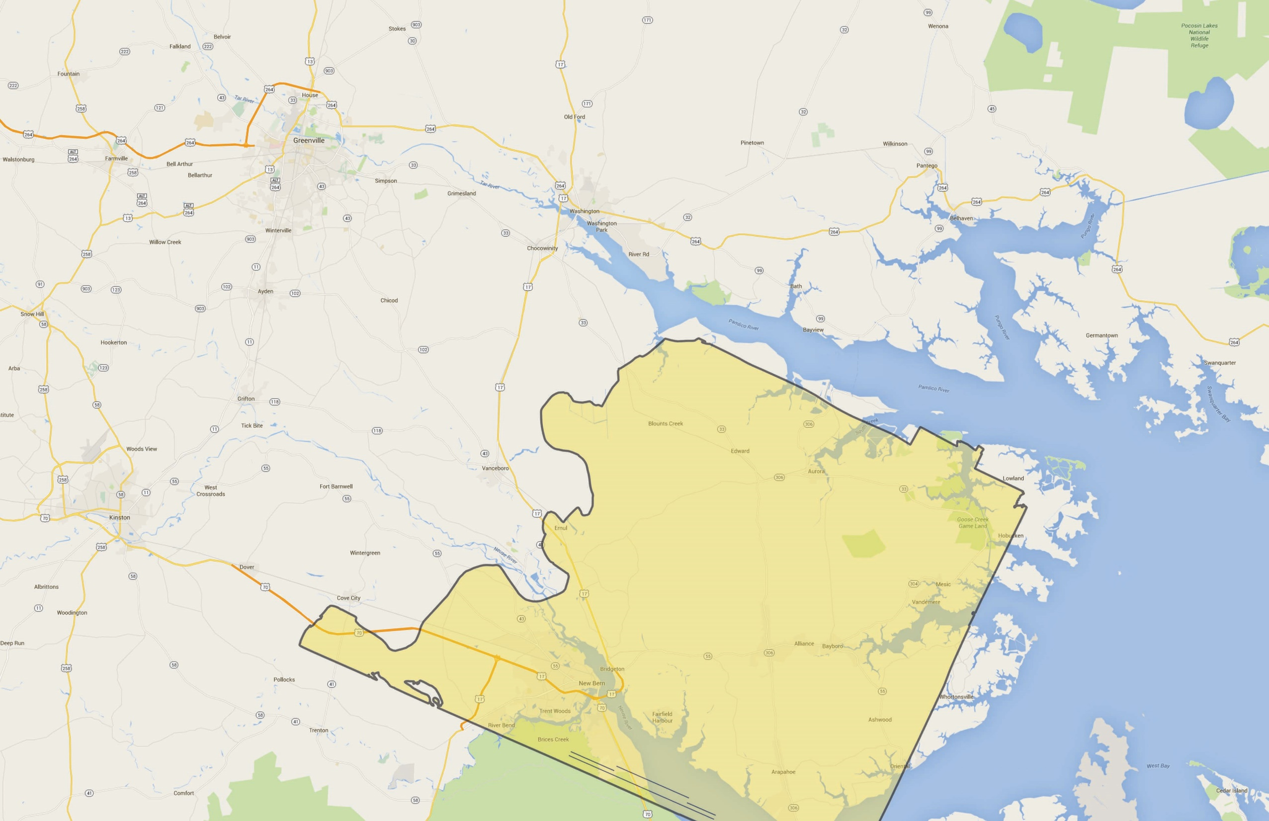
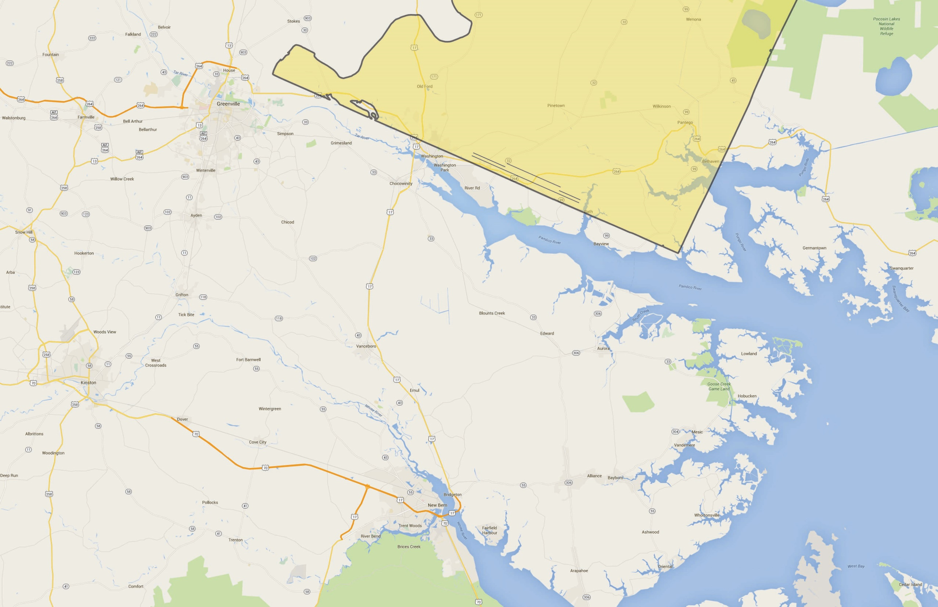
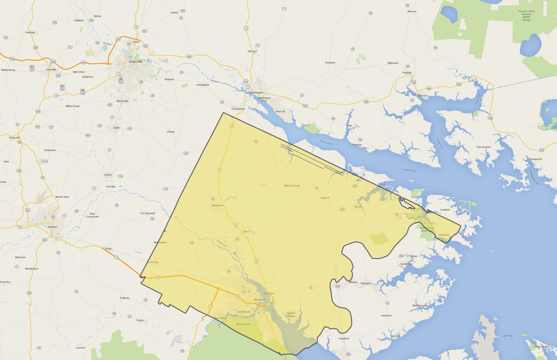
NIST Center of Excellence for Risk-Based Community Resilience Planning
A side of Shelby County along the river (small superimposition with the river)
5
6
7
8

Slide 4
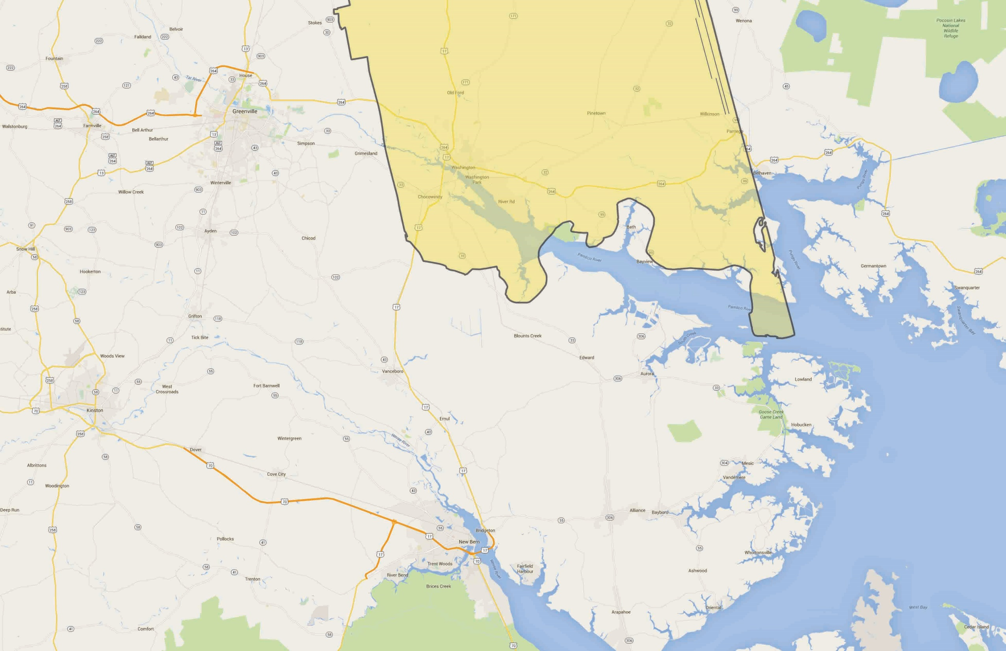
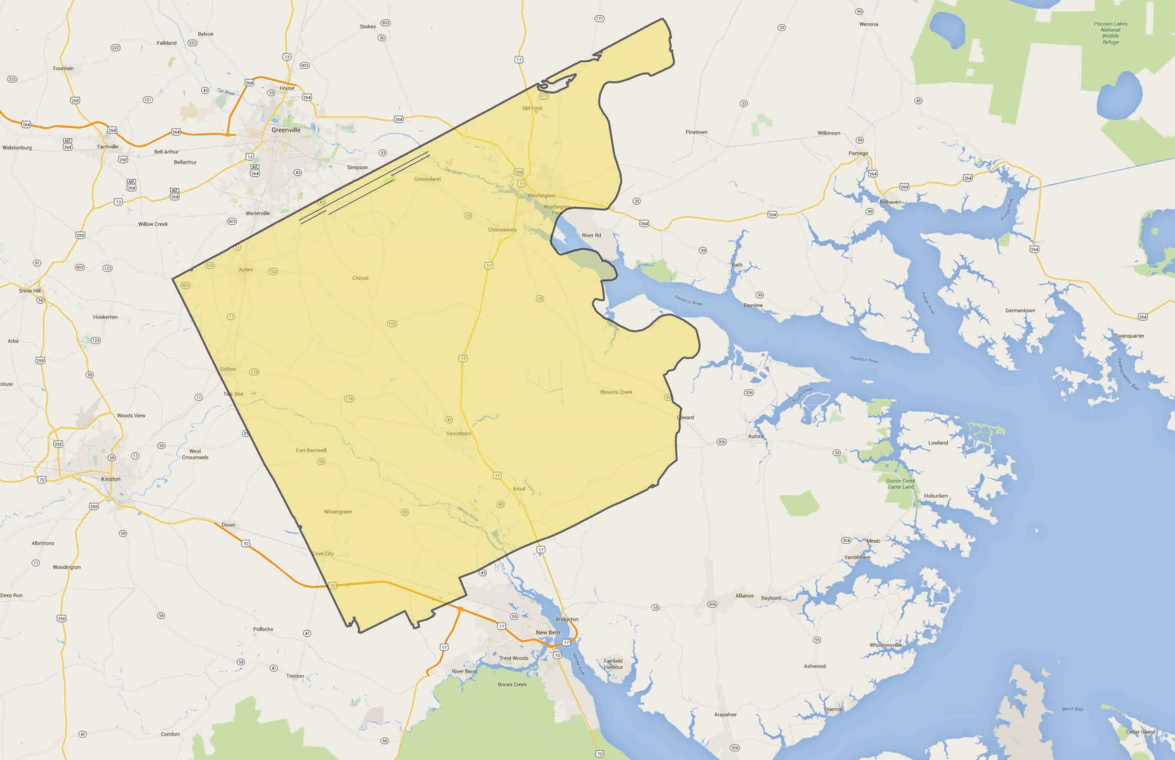
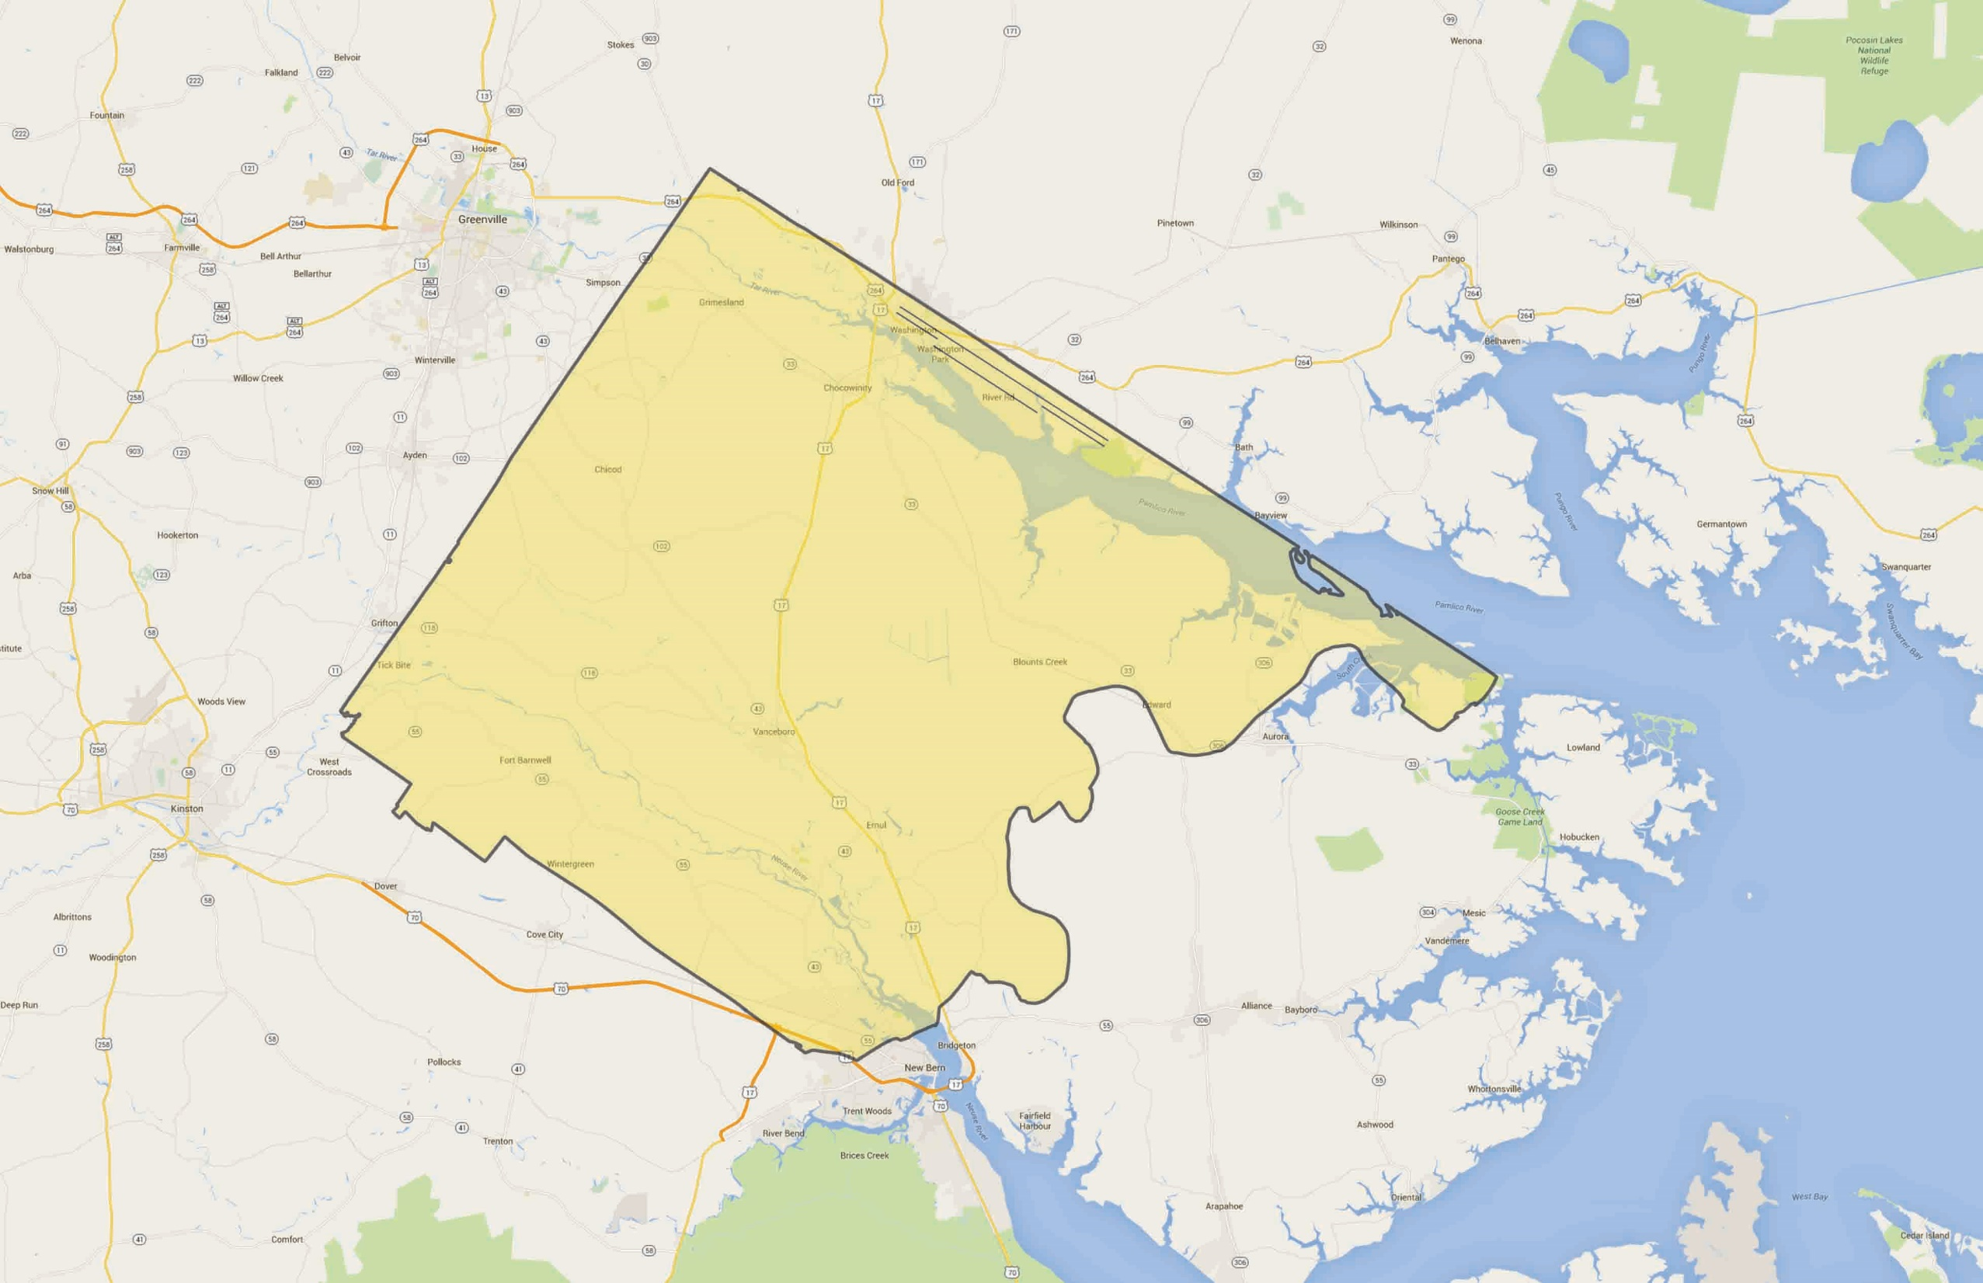
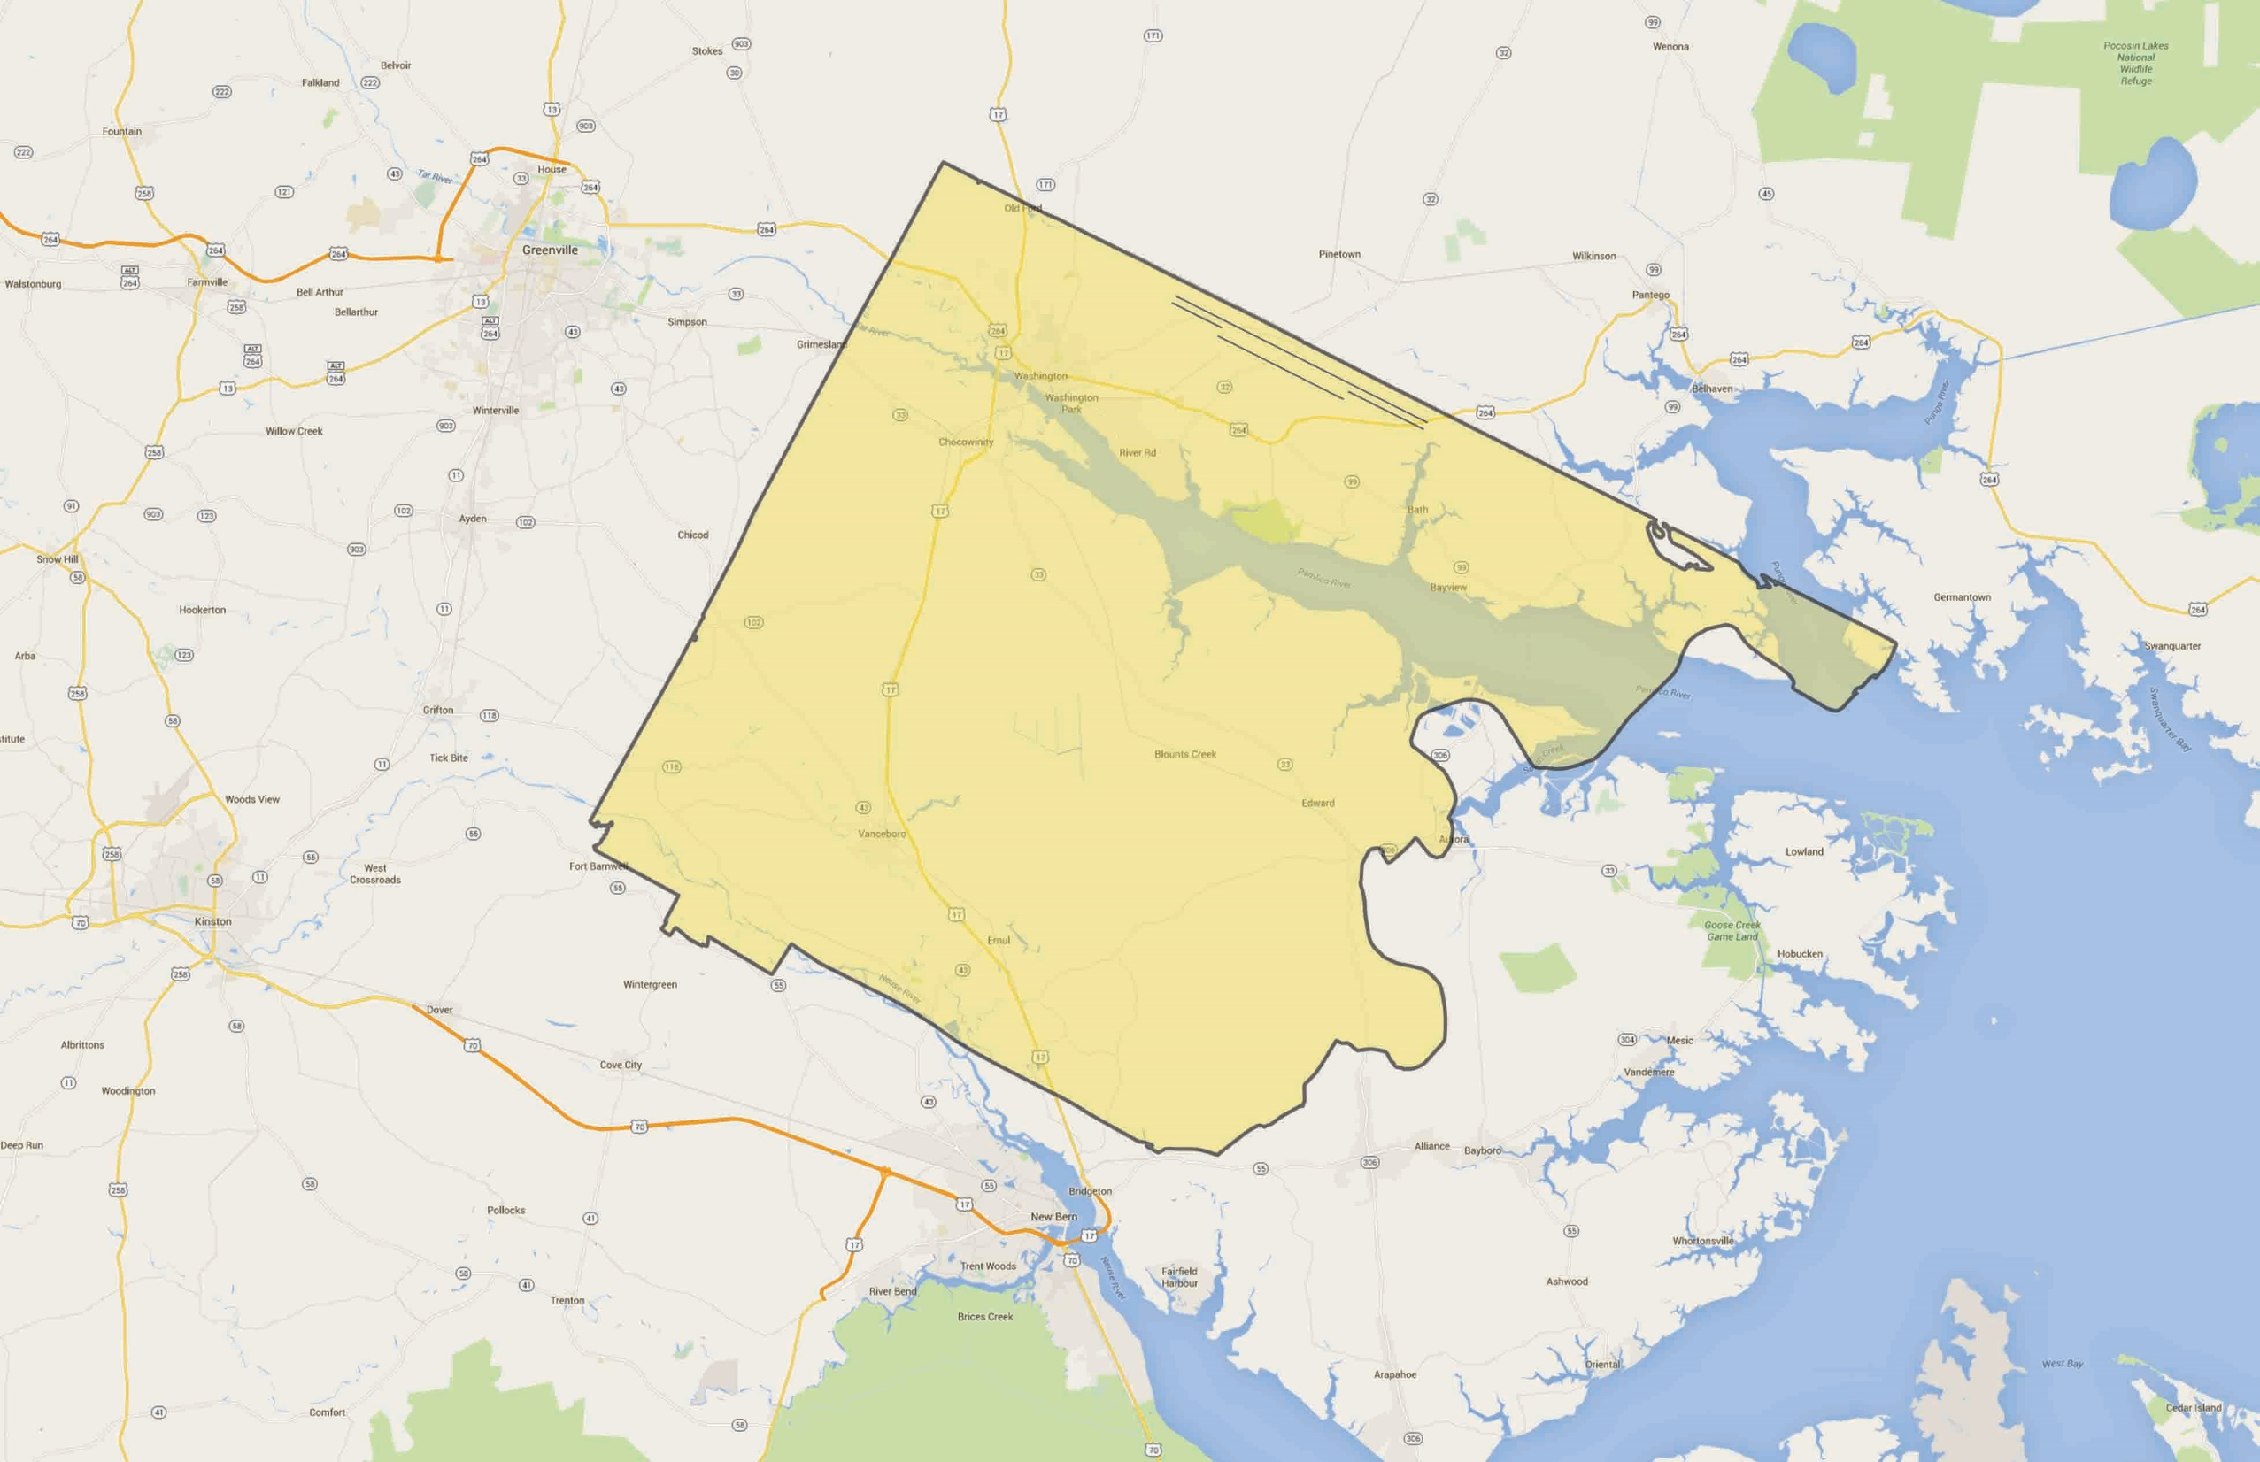
NIST Center of Excellence for Risk-Based Community Resilience Planning
Memphis area close the river (large superimposition with the river)
9
10
11
12

Slide 5
NIST Center of Excellence for Risk-Based Community Resilience Planning
Notes:
The contour of Shelby County includes, in the western part, the Mississippi River. Therefore, in option 10 the superimposition with the Pamlico river is negligible
Options 6 and 8 are those where the contour of Shelby County is closest to the shoreline
In option 8 the part of Shelby County superimposed to the Neuse River (on the south) is almost completely a park (Meeman-Shelby Forest State Park)

